Slide 1
Dark Pattern Detector
- D20125012 Jordan Donnelly
- D19127378 Alan Dowley
- D20123758 Yunpeng Liu
- D19124089 Lan Zeng
- D18130277 Yufei Su
- D19126879 Quanwei Sun

Slide 2
About the Project
Shopping tricks finder
A Chrome Extension.
Detects and highlights dark patterns on shopping webpages.
dpexplain.com
An educational website.
Helps users get a better understanding on what dark patterns are.
Aims of the projects
Create a dark pattern detection tool
Provide users with an education and awareness of what a dark pattern is
To help people to stop falling victim to these patterns
Project components

Slide 3
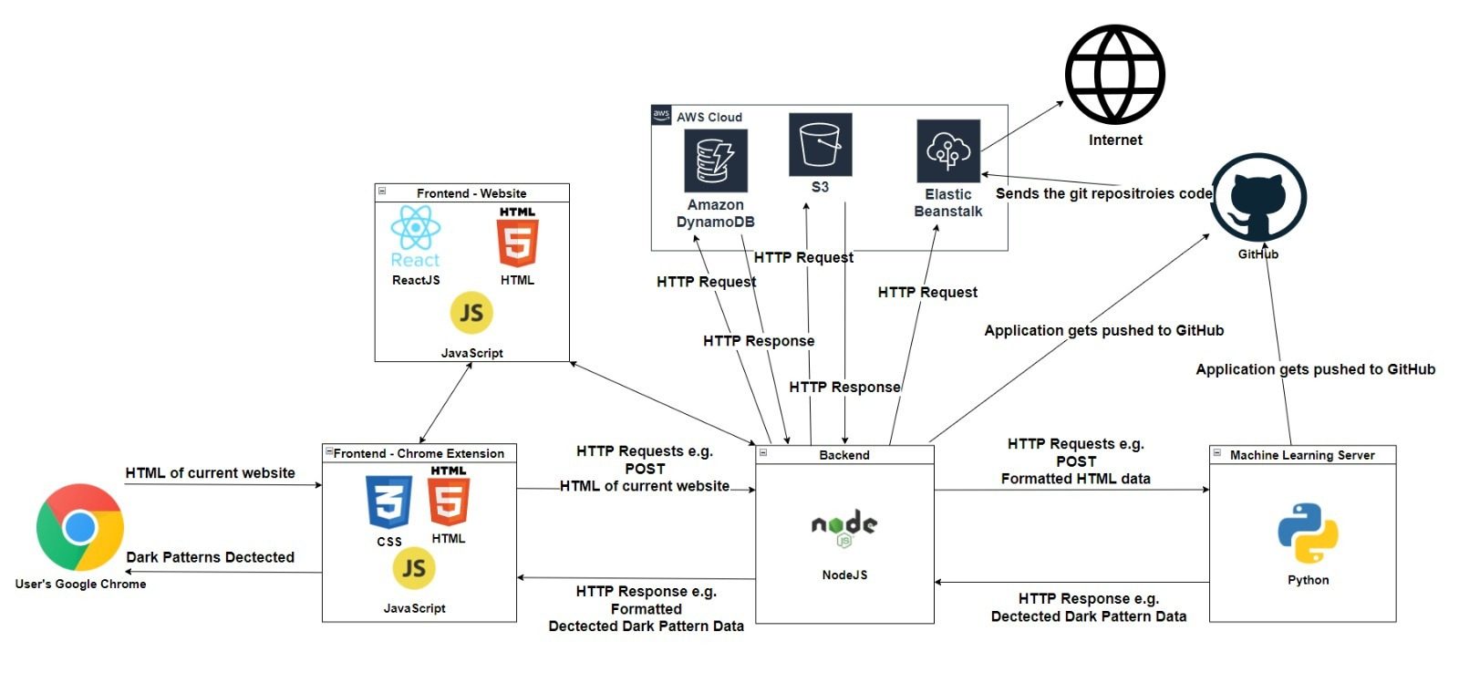
System Architecture

Slide 4






Pattern Type | Detection Strategy
Fake Activity | (1) Gather the text content of the HTML on the webpage. (2) Apply Natural Language Processing in machine learning / deep learning to achieve fully automatic detection of these 5 pattern types, based on the text only.
Fake Countdown
Fake Limited-time
Fake Low-stock
Fake High-demand
Confirmshaming | (1) Gather the text of the buttons and links on the webpage. (2) Use Natural Language Processing in machine learning to achieve fully automatic detection based on text only.
Dark Pattern List
(5 DP Types + Confirmshaming DP)

Slide 5
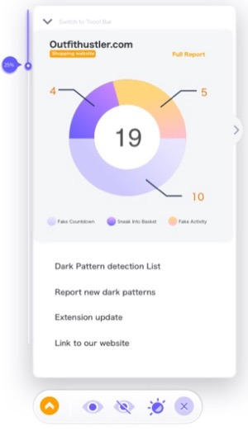
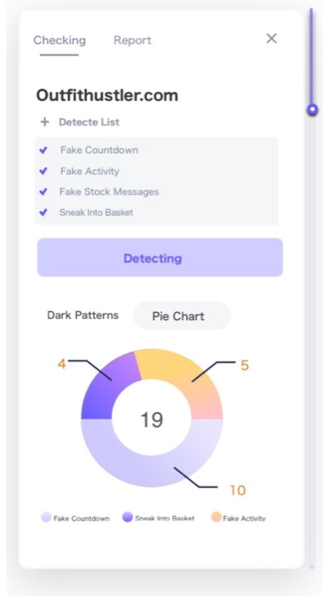
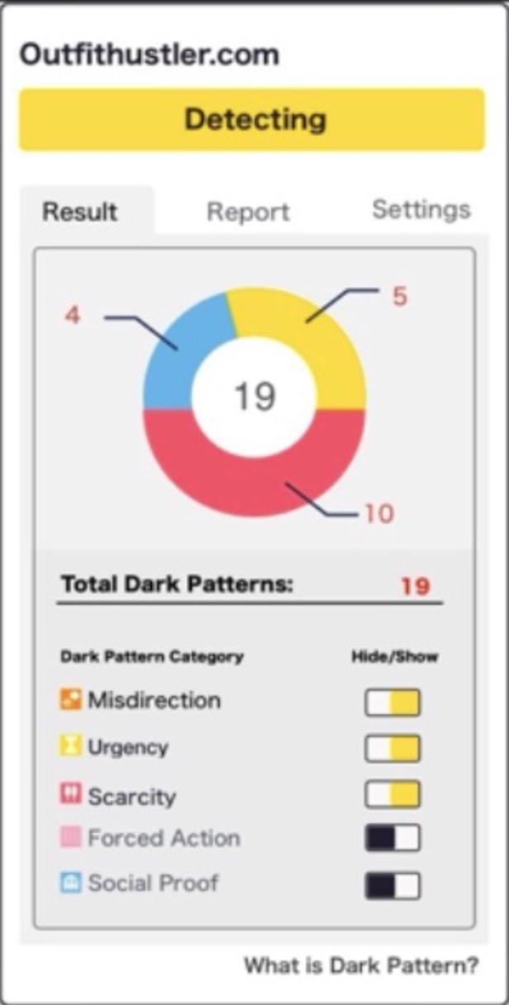
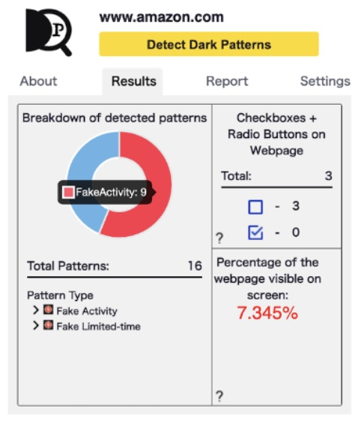
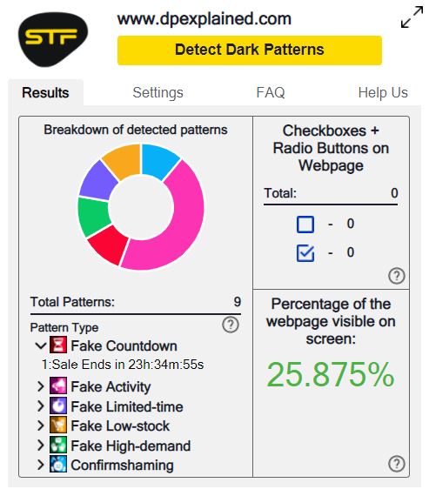

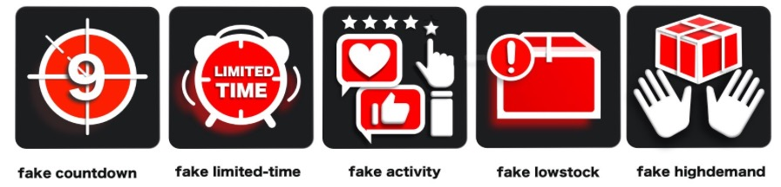
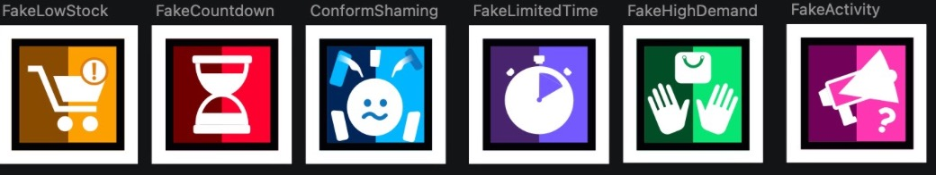
User Evaluation Timeline
1. Think Aloud
2. Cognitive Walkthrough
3. Questionnaire
4. Heuristic Test
5. AB Testing
1.Think Aloud
2. Cognitive Walkthrough
3. Questionnaire
4. AB Testing
1. Think Aloud
2. Cognitive Walkthrough
3. Questionnaire
1.Think Aloud
1.Think Aloud
Version1
Version2
Version3
Version4
Version5(Final Version)

Slide 6
Frontend Development Lifecycle
A side window style UI + ToolBar, injected onto page through a content script.
UI was inheriting styles from webpages it was opened on.
Presenting our data through a content script was difficult.
A side window style UI to be a webpage shown through an iframe.
Made message and data passing in the extension very complicated and unreliable.
UI to be in the popup of the chrome extension.
Removed all problems that came with the before solutions
However no longer possible for UI to be a side window
Toolbar was scraped as it served a limited purpose
UI size increased so more info and features can be displayed
FAQ section, checkbox scanner and percentage of page visible added.
Final version of the extension at the end of this stage.

Slide 7
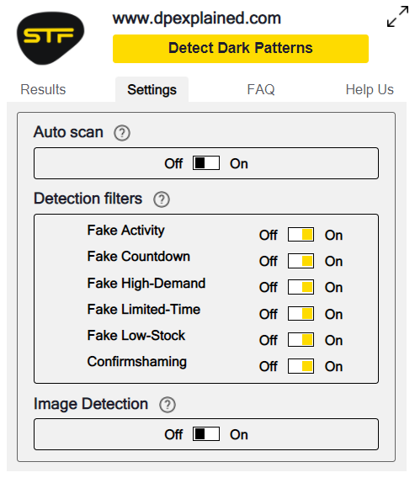
Features and Functionalities
Customizable settings
FAQ Section
UI enlargement
Displays number of check and un-checked checkboxes
Locate detected patterns on the page
Toggle Auto scan
Choose what patterns get detected
Six different types of patterns
Shows percentage of the webpage visible on screen
Choose to use OCR when detecting

Slide 8
Backend Lifecycle
Node Server
Restful API
Restful API using AWS services

Slide 9
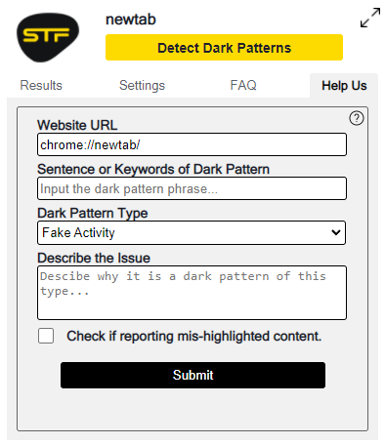
Backend – Report life cycle
Chrome Extension
User sends a report.
Node Server
Formats appropriate data.
AWS DynamoDB
Stores the data into the database.
Management Website
The reports are listed here to be screened.
AWS DynamoDB
If the report is accurate, then it is stored in the Dataset database.

Slide 10
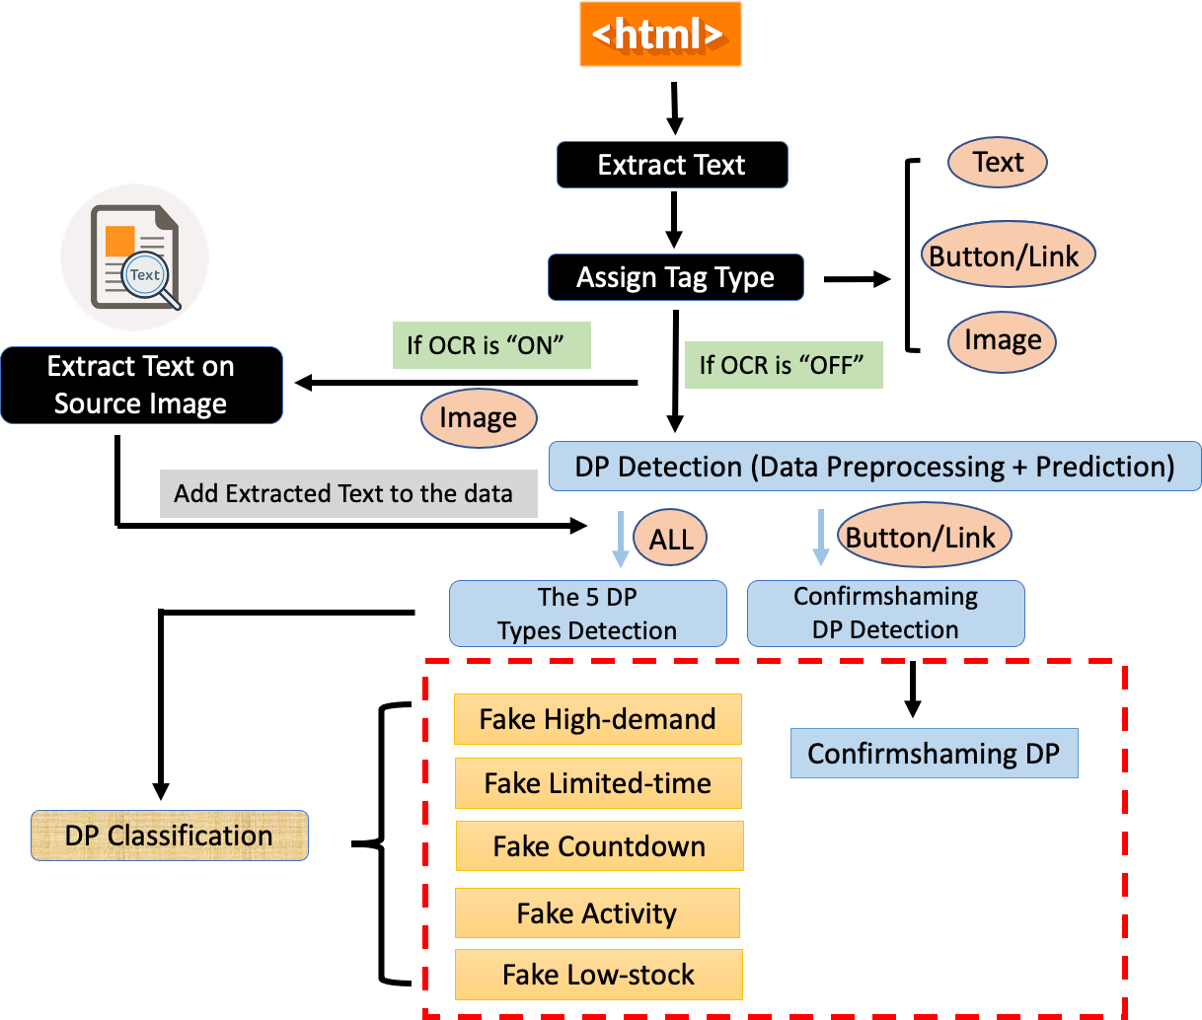
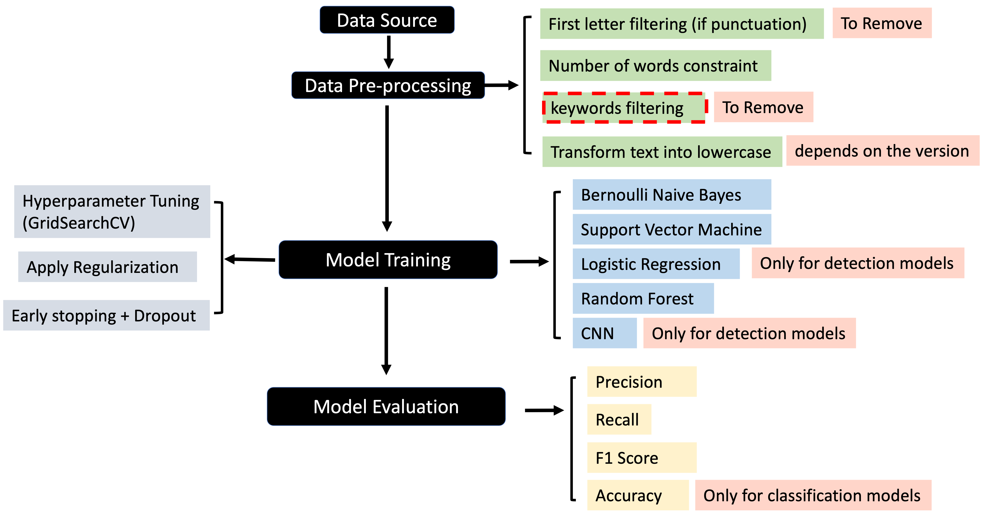
Data lifecycle
Real-time Dark Pattern Detection Process
Dark Pattern Detection and Classification
Model Training and Evaluation Process

Slide 11
Model Versions Development
7 DP (Dark Pattern) Category Detection + Classification (Deployed)
1. DP Category Detection and Classification
7 DP Category Detection Improving
8 DP Types Detection
1. Filtered data including only 5 dark pattern types
2. Found the overfitting caused by certain type of noise
Noise-removed 5 DP Type Detection (Deployed)
1. Removed noises in the data, e.g., detailed size, location, product name info
2. Problem: overfitting existed on keywords
3. Add keywords filtering in data preprocessing
5 DP Type Classification (Deployed)
1. Pattern type classification retrained on 5 DP dataset
2. Problem: Low precision (high FP rate)
1. Enriched dataset with misclassification data
5 DP Types Detection
1. Filtered data including only 8 dark pattern types
2. Problem: Precision score was still low. Because of "Trick Questions" and "Pressured Selling"
Enriched Dataset 5 DP Type Detection + Classification (Deployed)
1. Enriched with web scraping data for detection and classification
2. Re-trained pattern types detection models and classification models.
2. Lowercase models and noise free models were trained but not useful
Confirmshaming DP Detection (Deployed)
Balanced Confirmshaming Data
1. Developed 6 versions including data before / after enriching
2. Case-sensitive and lowercase models were trained and compared
1. Balanced training data using Random Duplicating Oversampling and SMOTE.
3. Problem: Bernoulli Naïve Bayes went into fully underfitting situation
2. Results: Bernoulli Naïve Bayes started learning but still went into overfitting.

Slide 12
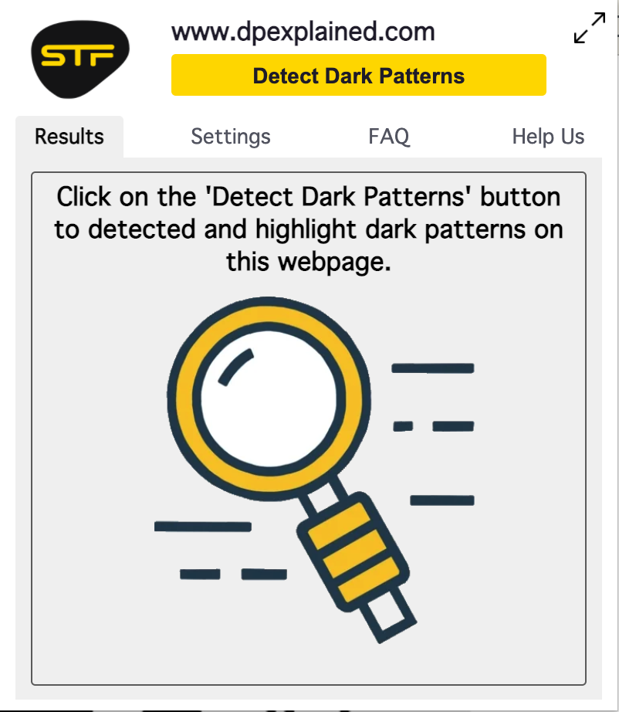
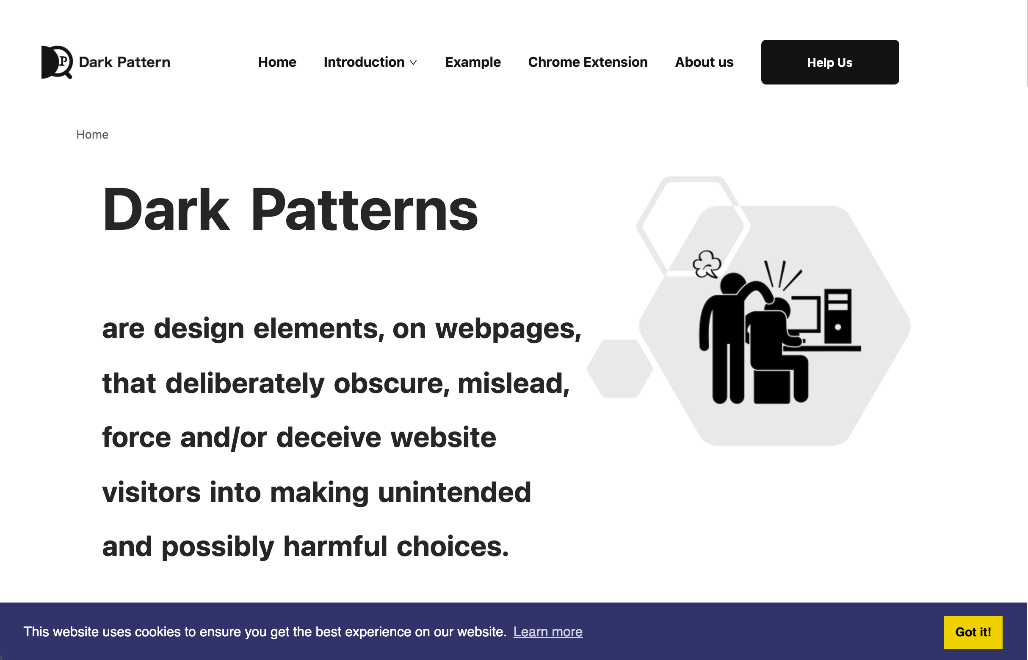
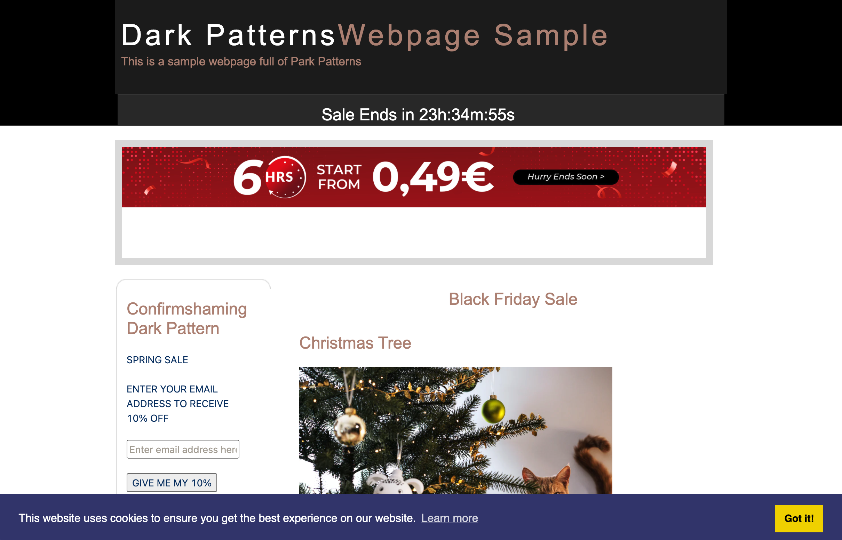
Project Output
Dark Pattern Educational Website
Dark Pattern Detection Tool
Sample Webpage for testing Dark Patterns

Slide 13
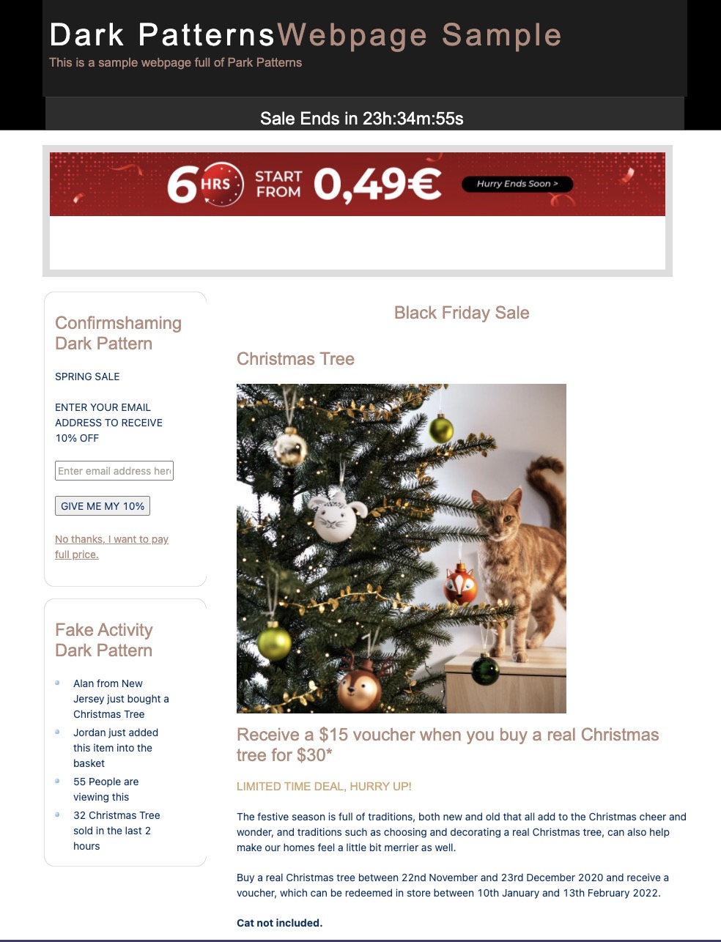
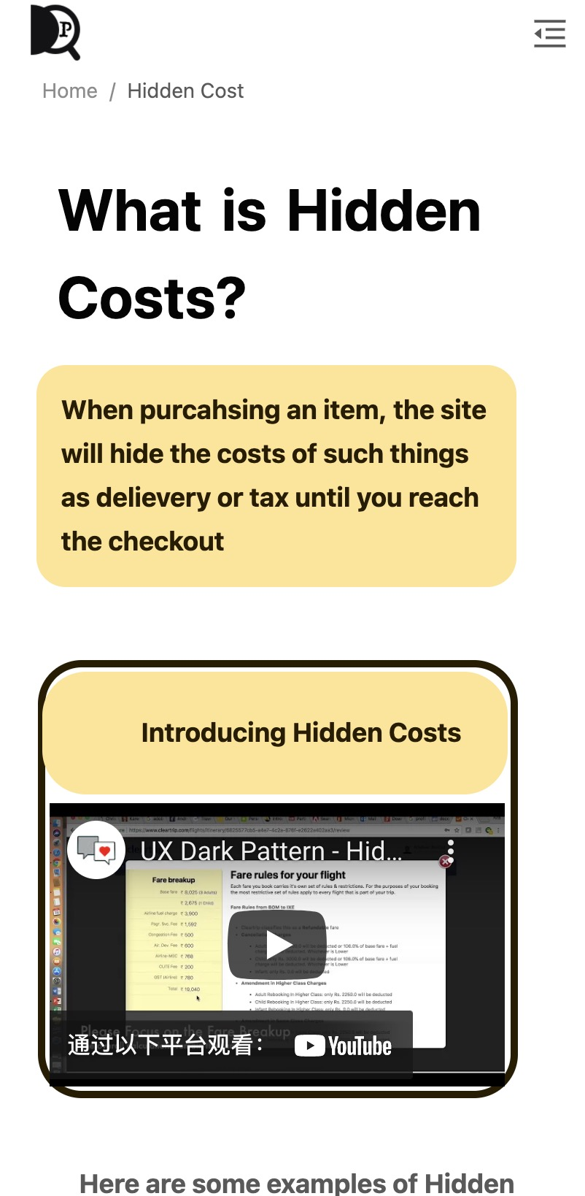
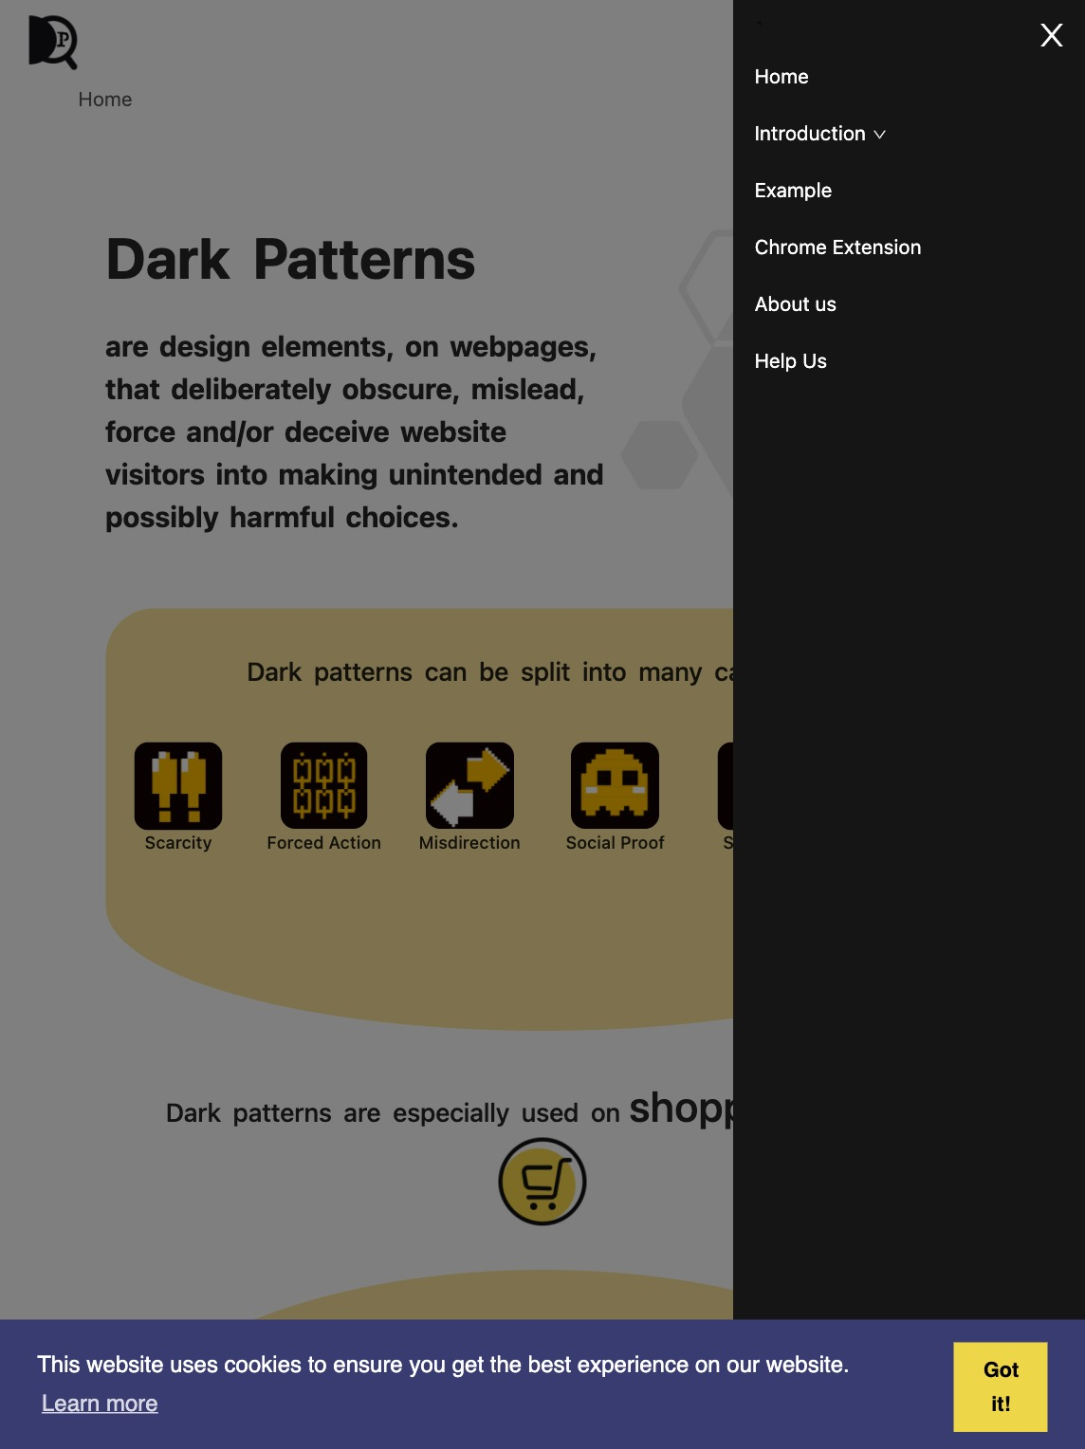
Dark Pattern Website
max-width:768px
max-width:1024px
Dark Pattern
Example
Page

Slide 14
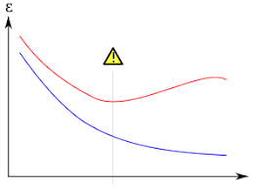
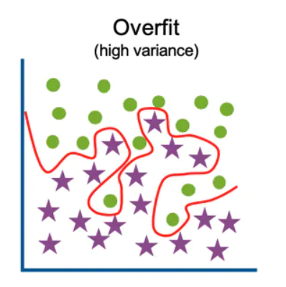
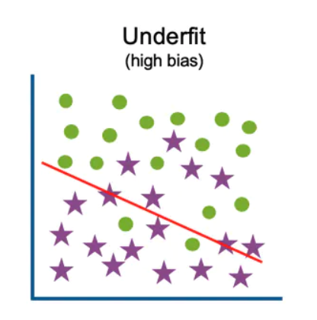
Challenges
Frontend and Backend
- Being able to run the extension across multiple tabs at once. ​
- The unpredictability of AWS Elastic Beanstalk. This service would fail for unknown reasons, taking much time to fix it.​
Some DP cannot be detected because of time, complexity, and have to detect manually
​
- Sneak into basket*​
- Hidden Costs*​
- Trick Questions*​
- Misdirection(manually)​
- Disguised Ads (Google already addressed)​
- Roach Motel(manually)​
- Forced Continuity(manually)​
- Privacy Zuckering(manually)​
- Price Comparison Prevention​
- Bait and Switch​
- Friend Spam*​
- Fake Review*​
​
* Theoretically possible​
​
​
Machine Learning Models
- Hard to recognize and handle noises in the data
- Handling overfitting and underfitting
Image Detection(OCR)
- Long detecting time(more than 40 secs)
- Low detecting accuracy

Slide 15
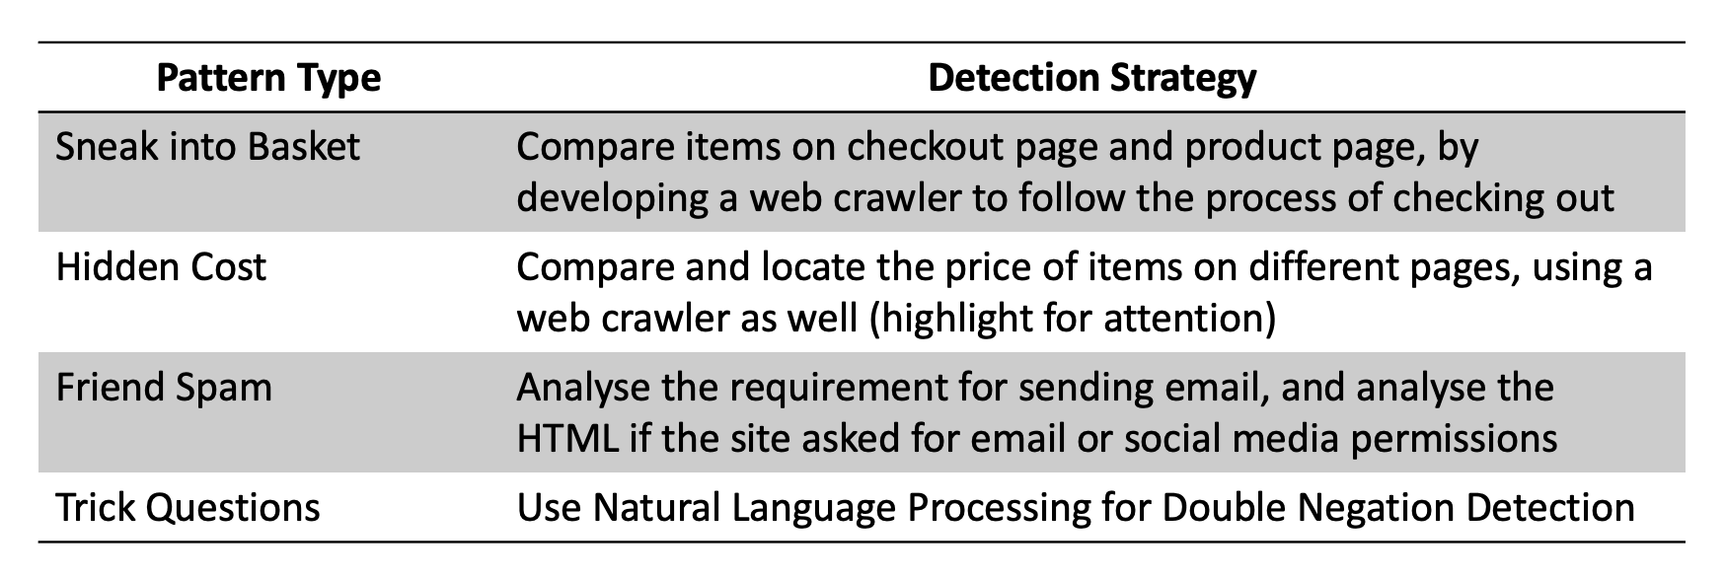

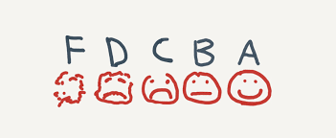


Future work
Dark Pattern Detection
Dark Pattern Educational Website
To develop a webpage for enhancing user interactive level,
which will include quiz and grading system for it.
Dark Pattern Sample Page
Keep Enriching with Examples

Slide 16

Thank you

